Slide 1

Notes:
Let us know investigate some themes to consider when using Teams for synchronous lessons

Slide 2

Theme 1
Expected behaviours in a session
Notes:
Ask delegates the following:
What are your school or college’s online expectations?
How does this complement the school behaviour policy and ethos?
How do you all ensure consistency of approach?
How do you involve your pastoral or behaviour team where necessary?
How often does the school review this process in light of accelerated teacher learning?

Slide 3

Theme 2
Creating a culture of learning online
Notes:
Ask delegates the following:
How can you ‘set the weather’ for your classroom? How can this replicate your face to face contact with learners?
How can you make this learning culture explicit during a lesson?
e.g. class memory, incident, sayings or class jokes?
How do you check in with learners on arrival?
e.g. use of emoticons, gifs or a word or colour in the chat?
What about at the end of a session?
e.g. leaving the session open at the end in case learners want to hang back and chat with you or one another

Slide 4


Theme 3
Being human
Notes:
Some ideas to share with delegates:
Paste your photo onto your resources for that personal touch - create a ‘teacher in the room to support you’ presence!
If you would prefer not to use a photo perhaps create yourself a Bitmoji, you can create yours to look like you and can be used to send motivational messages to your learners, they can be used in your lessons quickly and easily by using the app.
Maybe your learners could create a Bitmoji for themselves to use in the lesson?

Slide 5
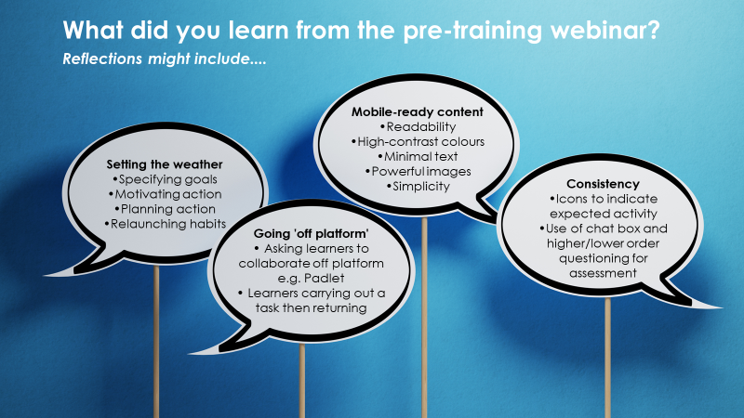
Theme 3
Engagement
Notes:
Refer back to the pre-learning ‘content and engagement’ webinar available here:
https://www.tmc.ac.uk/study-with-us/edtech/content-engagement

Slide 6

Theme 4
Making progress
Notes:
Ask delegates the following:
How can you ensure all learners contribute?
e.g. keep a log of who has answered a question with a series of ticks next to names
What tools do you have to monitor progress:
* throughout the session e.g. quick polls, use of timed response in the chat box
* at the end of the session e.g. online surveys, task completed and ‘handed in’
How can you support those learners who need additional support during a session? Differentiation - HAPS? LAPS?
e.g. setting a timed activity ‘off Zoom’ for learners to complete whilst you stay with a smaller, sub-group
High stakes exam questions vs regular, low stakes tests – in case HM Govnmt change the assessment process?
Mention the follow-up ‘Planning for assessment’ seminar. If they can’t attend there is a recording here:
Part 1: https://www.tmc.ac.uk/study-with-us/edtech/sequencing-learning
Part 2: https://www.tmc.ac.uk/study-with-us/edtech/sequencing-learning

Slide 7

Break time breakout rooms. Chat/music and downtime.
Walk about, stretch, focus on infinity, drink fluids
Notes:
Some thoughts to share with delegates:
Online sessions can be tiring. For learners and teachers.
Anything over 45 mins requires time away from the screen for a break.
Build these into your sessions to avoid cognitive overload. What could these breaks look like?

