Slide 1
Positives of Digital tools
Supports digital literacy skills for students
Keeps colleagues digital skills current
Can be accessed anywhere at any time
Can be used as an assessment tool
Promotes collaboration
Quick to implement
Fun and engaging
Lots of them are free to use
Notes:
We will now show you some digital tools that support assessment in the blended learning context.

Slide 2
Quiz assessments
Good for providing teachers with information about how much a student knows and what they still need to learn to inform future planning
Help students take advantage of the benefits of ‘retrieval practice’, where recalling things from memory actually helps to strengthen retention of that knowledge – disguised in a fun activity
Gets students used to answering questions – frequent quizzing can reduce overall test anxiety (Smith, Floerke,& Thomas, 2016)
A hybrid format of short-answers and multiple-choice format work best (although multiple-choice is easier to mark)
Self-check quizzes with no need for marking – saving time

Slide 3

Pros
Uses
Fun
Points – can use to assess/show progress
Mix and match question types, including image answers
Timed activity – adjustable timer
Can be created quickly
Existing Kahoot! quizzes that are ready to use/adapt
Can be used on mobiles – QR code
Team mode
Homework
Encourages competitiveness and quick thinking
student-paced challenges, questions and answers are displayed on players’ screens and you can turn the timer off
Review and assessment tool
True/false
Short tutorial: https://www.youtube.com/watch?v=KJgZZQcsSPk

Slide 4
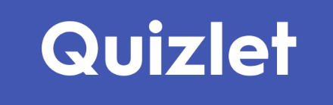
Pros
Uses
Multiple study options – flashcards, spell, test, matching games (with timer and leader board)
Visual and written content
Screenshot/grab and share
Can create your own study sets
Browse ready to use resources, including GCSE resource centre
Mobile App
Assessment of knowledge
Retrieval practice
Multiple study options allow for personalisation
student-led – students can create their own sets
Homework/revision
Short tutorial: https://youtu.be/7oJk0IBynoU

Slide 5
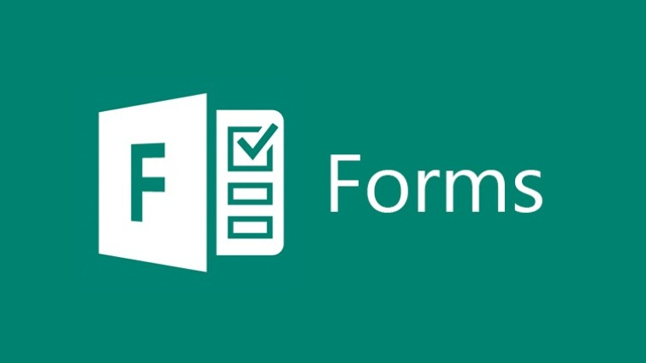
Pros
Uses
Accessible to all
Easy for you to track who is completing what
Access to your students’ results quickly, effectively and almost effortlessly
Variety of question types
Assessments – tutor and peer
Feedback
Polls
Rating/voting
Short tutorial: https://www.microsoft.com/en-gb/videoplayer/embed/RE1YlVu?pid=ocpVideo0-innerdiv-oneplayer&postJsllMsg=true&maskLevel=20&market=en-gb

Slide 6

Pros
Uses
Variety of question types
Links to a video clip to ensure they have watched it
Cannot skip the video
Cannot skip questions
Assessment of understanding
Can give written feedback
Can be used for long answer questions (good for exam technique)
Short tutorial: https://www.youtube.com/watch?v=y1cdFvU-7Mk

Slide 7

Pros
Uses
Access to 25,000+ diagnostic questions.
Diagnostic questions are designed such that each incorrect answer reveals a unique misconception.
These identify what each student doesn't understand and why they're going wrong.
Assessment of gaps in knowledge.
Identifies misconceptions in understanding.
Allows a teacher to focus on interventions and target groups.
Short tutorial: https://www.youtube.com/watch?v=farj-M4w6dg&t=128s

