Slide 1
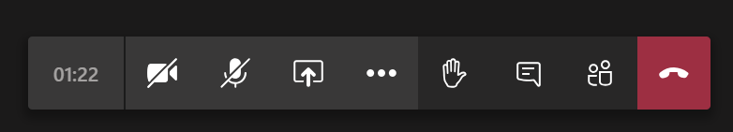
Microsoft Teams Tool Bar Handout.
Mic mute on and off
Mute your mic unless asked to speak.
Raise your hand
Use this to ask a question.
Remember to click again to put your hand down.
Show participants.
Click on this to see who is in your lesson
Timer
Shows how long you have been in the lesson / working on an activity
Leave the lesson
Hang up to leave the lesson.
Camera on and off
This is where to turn your video camera on and off.
Keep it off unless you have been asked to turn it on.
Screen sharing
Here you can share you screen.
Do not share your screen unless you are requested to.
Chat box
Shows conversation
Click here and a pop up will show you the meeting chat.
Notes:
You could provide students with a handout to support them to use main tools within Teams

Slide 2

Theme 2
Support, recording and streaming

Slide 3


Notes:
Your students need to know WHO to contact if they have any issues – these might be technical, practical or support related. They also need a point of contact to report any inappropriate online classroom behaviour, such as offensive comments or intimidating private messages from their peers. Let your students know your office hours and when they can reach you for questions.
You could include a FAQ document on your Teams page for students to refer to or set up a Question and Announcement Forum – a go-to place for information where students can also provide the answers to each other’s questions!

Slide 4


Notes:
Paste your photo onto your resources for that personal touch (create a ‘teacher in the room to support you’ presence!)
If you would prefer not to use a photo perhaps create yourself a Bitmoji, you can create yours to look like you and can be used to send motivational messages to your learners, they can be used in your lessons quickly and easily by using the app. You can find the link to this app in your takeaway item. Maybe your learners could create a bitmoji for themselves to use in the lesson?
Connect with students individually: It can be difficult to gauge how students are faring without seeing them in person, so connecting individually is very important. You can support students 1:1 in a chat, creating a safe space for students to ask their questions and get the extra help they need.

Slide 5

Prezi
Lynx
Powtoon
Notes:
Record voiced-over Power-Points and upload to Stream to create an accessible bank of resources for students. You can also use other software – Prezi, Powtoon, Lynx, etc.

Slide 6

Theme 3
Virtual community, ice-breakers and breakout rooms

Slide 7

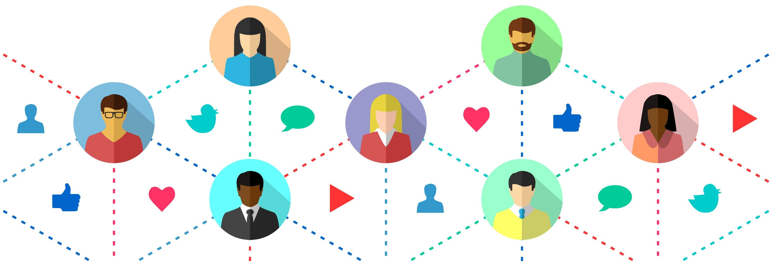
Creating a sense of community
from the beginning
Notes:
Tutors can help to create a sense of community by providing ways for students to introduce themselves to each other. For example:
Create a discussion thread with instructions for the student, typically asking students to post their name, career hopes, hobbies, and perhaps an interesting fact about
Padlet wall on which students post different images representing themselves and their interests.
Student introduction posts through a narrative:
A student writes the first section of a fictional story at the end of their discussion post. The next person to respond to the thread must continue the story. The third person will continue from the second person, and so on.
Students given free reign over the story’s content and direction, and are encouraged to have fun with it, and think outside the box

Slide 8


Notes:
Playing card connections:
Ask each participant to bring a few playing cards to the virtual meeting, or provide images of playing cards.
• Create six icebreaker or debriefing questions.
• Ask participants to select six cards from their deck, Aces through six.
• Have them shuffle their small deck and take turns turning over their first card. Whatever number card is face up they would share their response to the corresponding question on your screen. For example, if someone turned over the two of spades, they would answer the questions “Name your two favorite holidays.”
• You could also provide images of the card faces and have participants select a number card.
• You could also have a deck of cards yourself on video and flip the cards over so the participants can see which card flipped over.
Similarly, you could use dice with questions.

Slide 9

Notes:
Choose images for a slide and ask your students to choose an image that best describes how you are feeling today or you can use an emoji scale like this one

Slide 10

Break time breakout rooms. Chat/music and downtime.
Transparency of teacher/tutor who can manage chat.

Slide 11

When will you provide feedback?
How will you provide feedback?
What will be your approach?
Notes:
5 mins
1. Discuss with delegates how will they support colleagues back at school.
2. How will they facilitate a discussion?
a) Peer review?
b) Peer planning and design of synchronous teaching?
c) How could they support one another?

Slide 12

You now know what good looks like.
What will you take away from today?
How might you incorporate this into your own practice?
Which two things will you change?
How could you support others in developing their synchronous practice? Peer review? Cascade training?
What else do you need to develop? What is missing from today?
Notes:
5 mins
1. Facilitator to review the training with delegates via chat box or microphone discussion including:
Agreeing what they should implement in their own practice.
Agreeing what they could do to support peers? Facilitator to suggest delegates carry out peer review of lesson recordings before cascading training to colleagues.
What are the next steps? The facilitator should encourage delegates to consider next steps i.e. sequencing and assessment of learning.
2. Facilitator to be available at the end to support individuals and discuss their emerging ideas.

