Slide 1
Quality assurance of online learning
A facilitation seminar for leaders of performance management and remote learning

Slide 2
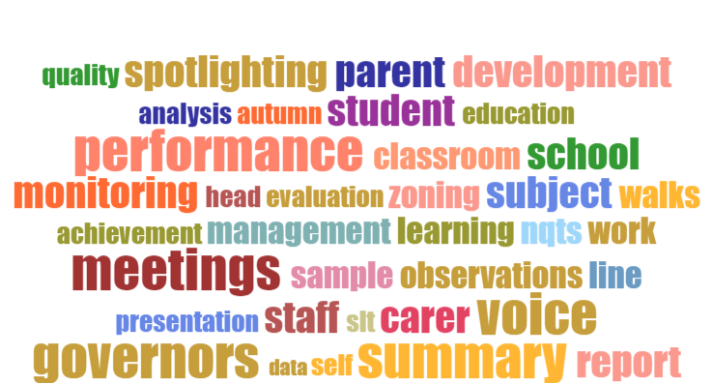
Quality assurance
What will we cover today?
Quality assurance – your school model pre-Covid
Developing your remote learning model
What needs to change?
Tracking progress data in your remote learning model
Monitoring of teaching and learning in your remote learning model
Moving to action – what will be your approach?
Notes:
Delegates invited to introduce themselves and their school context.
Facilitator introduces themselves.
Facilitator to explain the process and outcomes from the session.

Slide 3
Pre-sign up survey – what did you say?
Insert sign-up returns here
Notes:
Review returns and discuss what will be covered

Slide 4
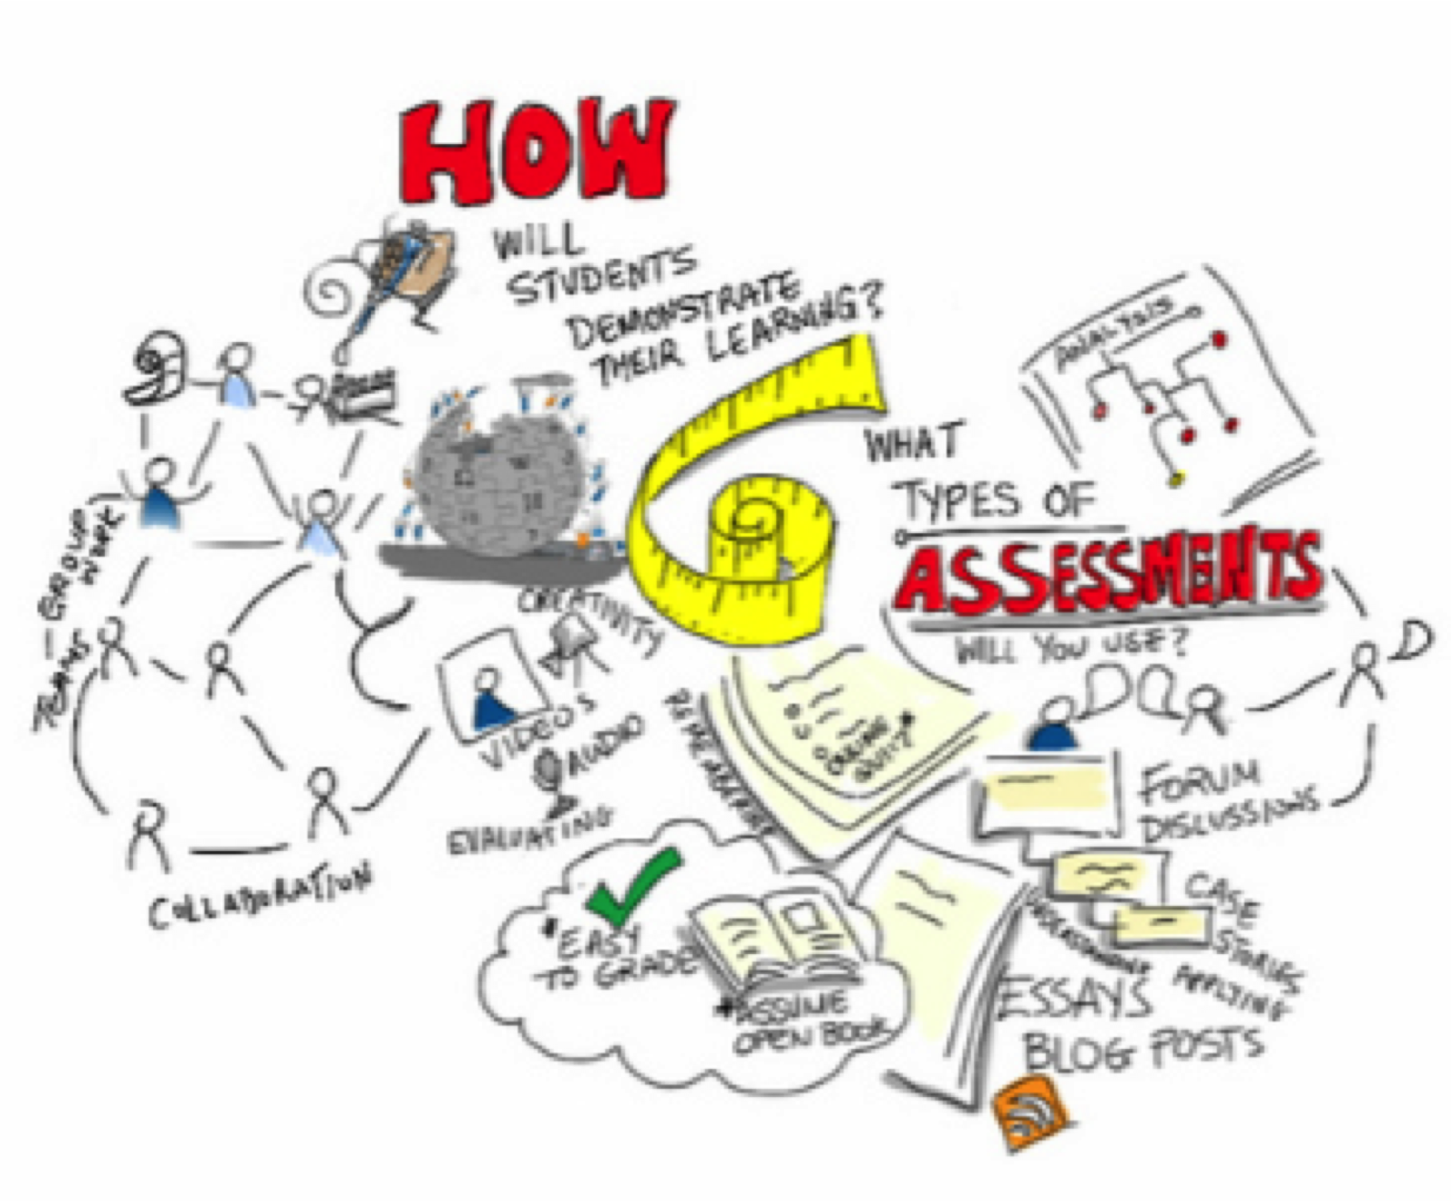
New assessment model at KS4 & 5 - evidence of progress?
Notes:
Student progress evidence portfolio:
any marked work
low stakes testing
formative assessments
extended assessments
departmental moderation
We’ll refer back to this later in the training.

Slide 5
Quality assurance - your school model pre-Covid
Monitoring of teaching and learning
OBservation
CONversation
“toward, to, on, over or against”
“together or with”
Discussion: where was your model last Autumn and how was it developing?
Notes:
Ask delegates to provide and overview of their school model including collecting progress data and monitoring of teaching and learning.
Had the model changed at the start of this year?
Had anything been changed? Why?
How was the model improved?

Slide 6
Quality assurance – how did you know?
Monitoring of teaching and learning
OBservation
CONversation
“toward, to, on, over or against”
DATA
“together or with”
Performance progress – how did you know?
Sequencing of learning – where was the data?
Notes:
Ask delegates to explain how they ensure their quality assurances processes are robust.
Who provided progress data and how often?
Who checks the data? How? Triangulation?
Monitoring of teaching and learning? How?
Coaches?
HODs?
SLT?

Slide 7
Developing your remote learning model
In the classroom
Synchronous teaching
Asynchronous learning
Discussion: where is your school?
Notes:
Delegates to provide an outline of their current model.
Where is your school on the diagram? How has it changed since the start of term?
What was the rationale for this approach?
Does it need to change?

Slide 8
Quality assurance – what needs to change?
In the classroom
Synchronous teaching
Asynchronous learning
Performance progress – how will you know?
Sequencing of learning – what additional data do you need?
Notes:
Delegates to consider quality assurance in relation to their remote learning model.
What additional data do you need to collect from remote learning to compliment data from the classroom?
How could this happen?
When will it happen in the sequence of learning?
How will data be aggregated and tracked?
What additional information is required to monitor the quality of teaching and learning?
Lesson reviews?
Learning walks?
Book looks?
Other?
Does the lesson review/observation process need to change? How?
Do SEF processes need updating?

Slide 9
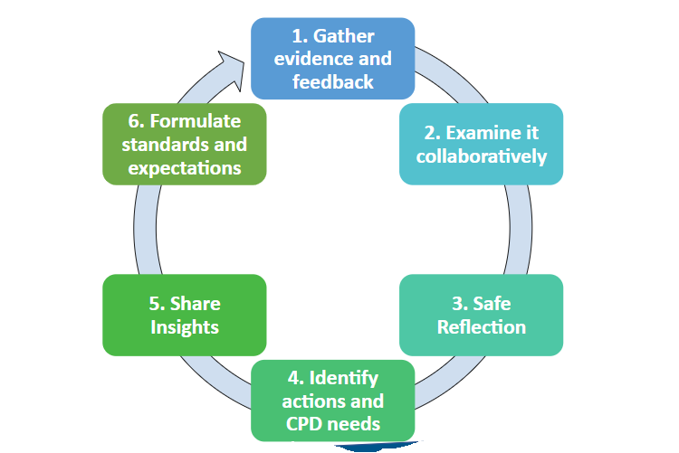
Collaborative development to improve understanding of quality in remote learning
Notes:
Outline the model and discuss benefits and downsides.
Benefits:
Staff well-being
The opportunity to trial in remote learning then expand across the whole quality system
Sense of shared community and collaboration
Agility and responsiveness
Downsides:
Introducing halfway through a cycle
Rigour of additional data
Exam board turbulence re: G.C.S.E.s
Are gaps being filled? How much of the gap should you fill?

Slide 10
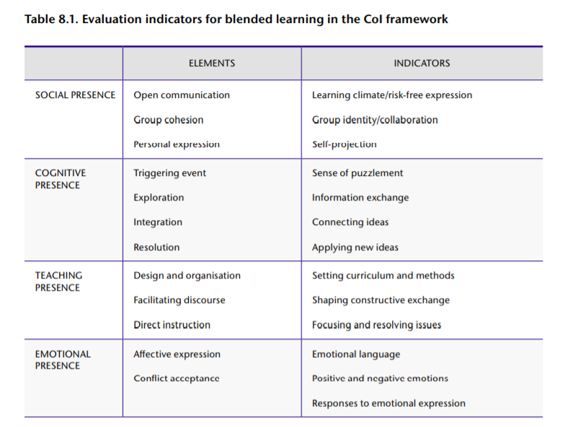
Using community of inquiry indicators to assess presence in blended learning
‘Guide to Blended Learning’ Martha Cleveland-Innes with Dan Wilton Athabasca University, Canada – chapter 8 and pages 74 to 78
Notes:
Facilitator to mention the importance of presence including social, cognitive, teaching and emotional presence.
Could a sub-set of the rubrics on pages 74 to 78 be used to quality-assuring your remote learning model?
Could communities of inquiry be established to quality-assure remote learning using the presence model or a variant?

Slide 11
A model to consider - The Manchester College
For synchronous teaching and asynchronous learning we need to consider the following themes:
Planning for learning (including the start of a lesson or before a recording is watched)
Managing learning
Communication
Activity and interactivity
Assessment and progress (including the end of a session or after a recording is watched)
Reflection and forward planning
Reviews of remote learning framework
Reviews of remote learning
process
Notes:
Monitoring the quality of teaching and learning in the remote learning model
The college wanted to start this earlier but there were concerns from leadership re: the qualitative measure of performance, underperformance?
Given the right tools a great, reflective practitioner makes a great, reflective online practitioner.
Is your organisation ready for such an approach?
Facilitator to provide an overview of the proposed model.
Framework
Process

Slide 12
Very helpful
What teachers said…
Review of Learning
Replaces ETLA this year
Findings from the pilot….
Supportive
RoL has made me feel more confident and I know what areas I need to work on to improve
It identifies areas for development not easily self recognisable
The skills I have learned (and viewing myself teaching) have enabled me to adapt and change how I ask questions and prepare resources
An opportunity to discuss what is working/not working, to take a section of T&L practice and reflect on that specific area
I wanted to make sure as a new teacher that I was doing my lessons online correctly, this gave me confidence to carry on and improve
I no longer have sleepless nights about planning as a direct result of the RoL
100% of teachers surveyed would recommend an RoL to a colleague
RoL
100% of teachers surveyed agreed or strongly agreed that professional, reflective discussions using the RoL framework helped them to improve
100% of teachers surveyed felt RoL had impacted positively on their practice
Thorough
Positive
Notes:
52 teachers in the pilot from across departments with teachers seeking solutions in a fast-moving situation.
How do we know this has worked?
Is this quality assurance or quality improvement?

Slide 13
Moving to action - what will be your approach?
Bolt on system?
Parallel systems?
Evolve existing system?
Pilot group?
Staff wellbeing?
How confident are you in the new data sets you collect? Do they reflect true progress?
Notes:
Facilitator to ask the following questions:
a) Will you keep your previous systems and simply bolt on remote QA?
If so, what does the bolt on look like? How will you ensure you collect the right data – the data that reflects true progress? How will you monitor the quality of teaching and learning?
b) Will you take the opportunity to adapt your previous system with a new approach? Can this be done mid-year?
c) A different approach – run two systems in parallel?
d) Teachers are new to remote learning (synch and asynch) – how can we ensure the process fully supports them? Staff wellbeing?
Could you trial the process with a smaller cohort then refine and roll out?
e) Student portfolio of evidence – marked work, low stakes testing, extended assessments, departmental moderation, progress?

Slide 14
Evaluation and feedback Please spend 5 minutes giving us some immediate feedback on what you have learnt today. This will be used to improve our offer to schools moving forward. https://forms.office.com/Pages/ResponsePage.aspx?id=4OQOG2ZRykO0ZwI86bscxJM0N8SVV9FImP3_BB6RC2JURDJVS1ZYWDZSU0xaRTdTMENZWVJFOVNGTy4u

