Slide 1
Positives of Digital tools
Supports digital literacy skills for students
Keeps colleagues digital skills current
Can be accessed anywhere at any time
Can be used as an assessment tool
Promotes collaboration
Quick to implement
Fun and engaging
Lots of them are free to use
Notes:
We will now show you some digital tools that support assessment in the blended learning context.

Slide 2
Collaboration tools
Collaboration is proven to deepen understanding
Collaboration can build problem solving skills
Gives students the opportunity to develop their employability skills such as team working, communication and accountability
Students have different skills and knowledge and these can be used to enhance learning when they collaborate and allow for peer led teaching
Small group collaboration allows students to engage, and gives them the opportunity to express their own ideas and develop their confidence. It gives a sense of belonging and being part of something.

Slide 3

Pros
Uses
Easy to use
Visual
Immediate
Embeddable
Brief responses tool (one word)
Initial thoughts
Word association
Level of knowledge
Online brainstorming
Classroom feedback
Opinion gathering
Short tutorial: https://www.youtube.com/watch?v=uD-8XQCnMK8

Slide 4
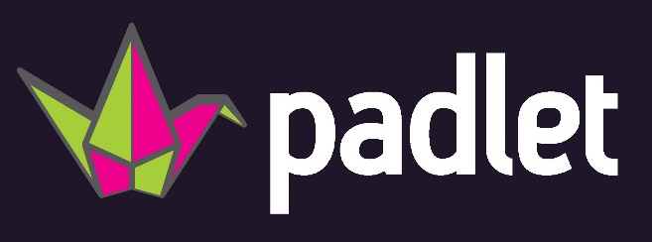
Pros
Uses
Fun and interactive
Range of different boards and formats
Real time updating
Inbuilt accessibility features
Mobile app
Get a school account – unlimited boards
Create boards, share link with students (URL or QR code)
Can download boards as images/pdfs
Collaborative working (suitable for social distancing)
Generating and sharing ideas
Voting – reactions
Reviews/discussions
Summary of learning – text, graphs, images
Giving feedback (upload an image/example of work and add comments)
Short tutorial: https://www.youtube.com/watch?v=gPhyFiJ3LNQ

